Slide 1

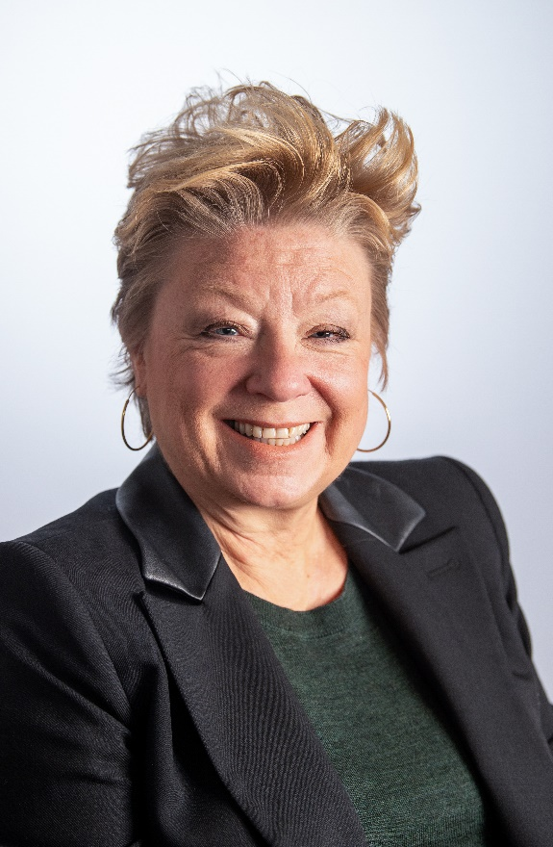
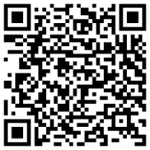
PSYC514: Individual Differences, Social & Developmental Psychology Lecture 3: Heritability
Dr Alison Bacon
How to get in contact
Email: ambacon@plymouth.ac.uk
Office: PSQ B218
Book an office appointment:
Mondays 2-3pm
Tuesdays 10-11am
Scan QR code or click here
Check in code
NG-FJ-FO

